Slide 1


Smart Stadium Staff App (OpsLite) — Project Kickoff
One Academic Year 2025-2026

Slide 2
Project Acronym
MVP — Minimum Viable Product.
UI — User Interface; UX — User Experience.
PT/EN — Portuguese/English (languages for the UI).
i18n — Internationalization; l10n — Localization.
WS — WebSocket (persistent two-way connection).
HTTP — Hypertext Transfer Protocol; SSE — Server-Sent Events.
API — Application Programming Interface.
MEC — Multi-access Edge Computing; Edge AI — AI at/near data source.
5G — Fifth-Generation cellular network.
QoS — Quality of Service (network performance guarantees).
KPI — Key Performance Indicator; SUS — System Usability Scale.
MAE — Mean Absolute Error (prediction accuracy metric).
BLE — Bluetooth Low Energy.
PII — Personally Identifiable Information.
ASR — Automatic Speech Recognition; TTS — Text-to-Speech; NLU — Natural Language Understanding.
STM32N6 — A class of STM32 microcontrollers used for embedded/edge AI (conceptual reference).
RBAC — Role-Based Access Control.

Slide 3

Project Objective & Outcomes
Build a lightweight staff mobile app for stadium operations (Security, Cleaning, Supervisor).
Minimum Viable Product (MVP) features: Crowd heatmaps & gate wait-times, maintenance (bin-full) alerts + shortest-path routing, role-based User Interface (UI) (PT/EN).
Stretch: VIP fast-track check (synthetic), suspicious/prohibited-item alert list (simulated).
Deliverables: App binaries + source, Edge/MEC emulator, synthetic data generator, test report, ethics/privacy note, demo video.

Slide 4
Roles & Team
Recommended student roles:
PM/Coordinator — planning, backlog, reporting
Mobile/UI Lead — Flutter/React Native, UX, i18n (PT/EN)
Backend/API Lead — microservices, WebSocket (WS), APIs
Modeling/Analytics Lead — queueing, routing costs, evaluation
QA/DevOps Lead — CI, tests, latency.
Cadence: weekly stand-up + biweekly demo/review.

Slide 5
MVP Scope & Acceptance Criteria
MVP features:
Crowd heatmap per gate/section (G/Y/R) with threshold alerts
Gate wait-time estimation (M/M/1 or M/M/k), uncertainty bands
Maintenance: bin-full alerts + shortest-path routing
Health emergencies: SOS intake, nearest-responder assignment, hazard-aware shortest path, rerouting
Evacuation: corridor closures & penalties; staff guidance routes
Role-based views (Security, Cleaning, Emergency), PT/EN UI
Definition of Done: Real-time updates, resilient networking, offline cache, reproducible demos.

Slide 6
System Architecture (High-Level)
Mobile App: Flutter (recommended) or React Native; offline-first store; WebSocket (WS) for live updates; HTTP fallback.
Backend: Docker Compose microservices: crowd-service, waittime-service, maintenance-service, emergency-service, gateway.
Data Sources (simulated): gate arrivals/throughput, bin fill events, SOS events, map graph (nodes/edges), hazard closures.
Security/Privacy: synthetic/anonymized data only; role-based access; audit log; transport security.

Slide 7
API & Event Examples (Unified)
Push live data via WS; use HTTP for queries/acks; keep schemas stable.
# WebSocket topics
/ws/crowd # gate counts & heatmap
/ws/waittime # wait-time updates
/ws/maintenance # bin events & assignments
/ws/emergency # SOS events, responder assignments, status
/ws/evac # evacuation advisories & closures
# Example messages (JSON)
{ "type":"crowd_update","gate":"G12","count":184,"heat":"red","ts":"2025-10-06T19:20:00Z" }
{ "type":"bin_alert","bin_id":"BIN-A12","fill_pct":92,"poi_node":"N27","ts":"2025-10-06T19:21:00Z" }
{ "type":"sos_event","id":"SOS-5a12","prio":"high","loc":"N42","details":"fainting","ts":"2025-10-06T19:22:00Z" }
{ "type":"responder_assign","sos":"SOS-5a12","responder":"u204","eta_sec":120,"route":["N10","N23","N42"] }
{ "type":"evac_update","closure":{"edge":"N23-N24","reason":"smoke"},"ts":"2025-10-06T19:23:00Z" }
# HTTP endpoints
GET /api/gates
GET /api/waittime?gate=G12
GET /api/route?from=N10&to=N42
GET /api/emergency/nearest?loc=N42&role=medic
POST /api/ack
PATCH /api/map/closure

Slide 8
Routing (A*): Hazards & Closures
Edge cost = distance + hazard penalty; skip closed edges; reroute on updates.
# Map graph (JSON) with hazards
{
"nodes":[{"id":"N1"},{"id":"N2"},{"id":"N3"},{"id":"N42"}],
"edges":[
{"from":"N1","to":"N2","w":10},
{"from":"N2","to":"N3","w":6},
{"from":"N3","to":"N42","w":8, "penalty":{"smoke":5,"crowd":3}}
],
"closures":[{"edge":"N2-N3","reason":"spill","since":"2025-10-06T19:15:00Z"}]
}

Slide 9
Modeling: Queueing for Gate Wait-Time
# M/M/1 Wait-Time Estimation (simplified)
# lambda = arrival rate (people/min)
# mu = service rate (people/min) per lane
# k = number of lanes (use M/M/k to extend)
rho = lambda / mu
if rho >= 1.0:
# unstable; cap or trigger alert
wait_time = 'High/Unstable'
else:
# Expected waiting time in queue (Wq) for M/M/1:
Wq = (rho / (mu - lambda))
# Total time in system (W) = Wq + 1/mu
W = Wq + 1/mu
wait_time_minutes = W
Start with M/M/1; extend to M/M/k if needed. Smooth inputs with moving average or Bayesian updates.

Slide 10
Algorithms: Emergencies & Evacuation
// Hazard-aware A*
function hazardAwareAStar(graph, start, goal, hazardPenalty):
for edge in graph.edges:
if edge.closed: continue
edge.cost = edge.length + hazardPenalty(edge)
return AStar(graph, start, goal, heuristic=euclidean)
// Nearest responder
function assignNearestResponder(loc, responders):
return argmin_r distance(graph, r.loc, loc)
// Incremental replan
onClosure(edge): updateGraph(edge); replan() // consider D* Lite for speed
Use penalties for smoke/crowd; replan quickly on closures.

Slide 11
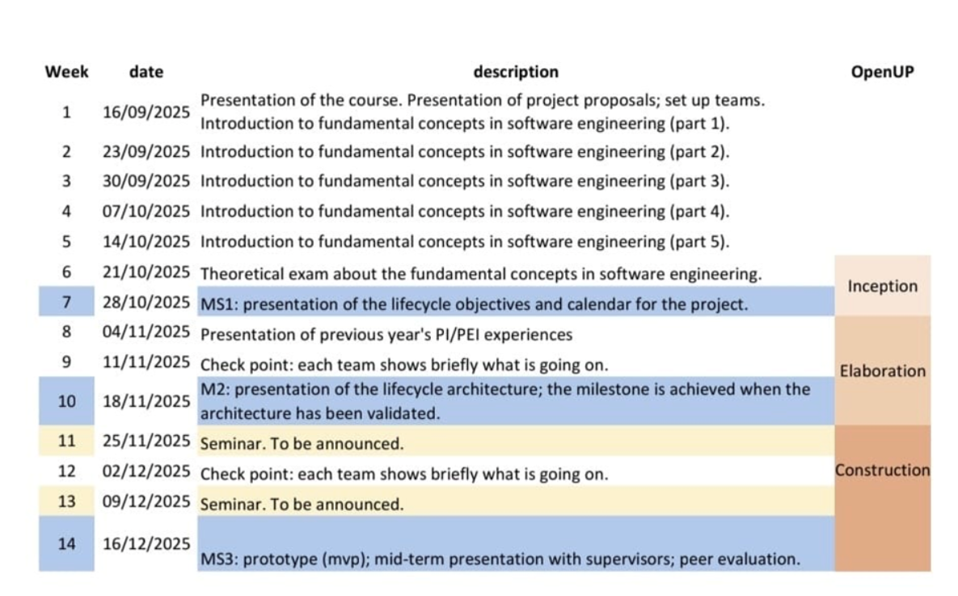
Semester 1 Calendar & Milestones
MS1: lifecycle objectives/calendar • M2: architecture validated • MS3: MVP prototype (mid-term).

Slide 12
Timeline (An academic year) & Milestones — Full Year
W1–W2: Vision, wireframes, API contracts, KPI targets (align with MS1).
W3–W6: App shell, role views, WS backbone, emulator scaffolding.
W7–W9: Crowd heatmap + thresholds, queueing v1, emergency flows.
W10: Milestone M1 (semester calendar): live heatmap + alerts + basic wait-time.
W11–W14: Maintenance + hazard-aware routing + reroute tests.
W15–W18: Robustness (offline cache, retries, fault injection).
W19: Milestone M2 (architecture validated end-to-end).
W20–W24: Optional: VIP check, suspicious/prohibited alert list.
W25–W28: Validation (usability tests, KPIs).
W29–W30: Final polish, report, poster, demo video.

Slide 13
Getting Started: First 7–15 Days
Repo & Continuous Integration (CI): create GitHub repo; set linting/format; CI for build/tests.
Wireframes: dashboard, alert detail, route view, settings (PT/EN).
Emulator: Docker Compose skeleton; WS that emits dummy gate counts each second.
Modeling: implement M/M/1 function with unit tests; small CLI demo.
Routing: load JavaScript Object Notation (JSON) map; A* route; draw polyline on the app screen and handle simple closure.

Slide 14
Resources & Tools
Mobile: Flutter SDK (recommended) or React Native; Android Studio / Xcode; devices or emulators.
Backend: Docker, Docker Compose; Node.js or Python microservices.
Dev: VS Code / IntelliJ; Git & GitHub; Postman/Insomnia; Make or npm scripts.
Testing: unit tests; Locust/K6 for load; tc/netem or toxiproxy for latency/loss simulation.
Maps: OSM tiles for visuals or custom SVG; in-app static graph JSON.
Docs: Markdown; draw.io diagram; OpenAPI/Swagger.

Slide 15
Security, Privacy & Ethics
Use
Use synthetic/anonymized data ONLY; no real faces/PII in the student project.
Audit
RBAC: roles for Security, Cleaning, Emergency; audit trail for actions.
Transport
Transport security (HTTPS/WSS) where practical; sanitize inputs; rate-limit endpoints.
Scope
Clear scope: operational insights only; no permanent storage of sensitive data.

Slide 16
Next Steps
Finalize MVP scope/backlog aligned with Semester 1 MS1–MS3 calendar.
1
Confirm unified schemas for crowd/maintenance/emergency/evac topics.
2
Implement hazard-aware A* and closure handling in emulator and app.
3
Prepare MS3 (mid-term) MVP demo script: surge + SOS + closure + reroute.
4

